Slide 1
Multitask Learning
Dr. Yan Yan

Slide 2
Transfer Learning - Overview
Source Data (not directly related to the task)
labelled
unlabeled
Fine-tuning
labelled
Multitask Learning
Target Data
unlabeled

Slide 3
Multitask Learning
The multi-layer structure makes NN suitable for multitask learning
Task A
Task B
Task A
Task B
Input feature
Input feature for task A
Input feature for task B

Slide 4
Multitask Learning - Multilingual Speech Recognition
states of French
states of German
states of Spanish
states of Italian
states of Mandarin
Human languages share some common characteristics.
acoustic features
Similar idea in translation: Daxiang Dong, Hua Wu, Wei He, Dianhai Yu and Haifeng Wang, "Multi-task learning for multiple language translation.“, ACL 2015

Slide 5
Multitask Learning - Multilingual
Mandarin only
Character Error Rate
With European Language
Hours of training data for Mandarin
Huang, Jui-Ting, et al. "Cross-language knowledge transfer using multilingual deep neural network with shared hidden layers." ICASSP, 2013
Huang, Jui-Ting, et al. "Cross-language knowledge transfer using multilingual deep neural network with shared hidden layers." ICASSP, 2013

Slide 6
Progressive Neural Networks
Task 1
Task 2
Task 3
input
input
input
Andrei A. Rusu, Neil C. Rabinowitz, Guillaume Desjardins, Hubert Soyer, James Kirkpatrick, Koray Kavukcuoglu, Razvan Pascanu, Raia Hadsell, “Progressive Neural Networks”, arXiv preprint 2016
Andrei A. Rusu, Neil C. Rabinowitz, Guillaume Desjardins, Hubert Soyer, James Kirkpatrick, Koray Kavukcuoglu, Razvan Pascanu, Raia Hadsell, “Progressive Neural Networks”, arXiv preprint 2016

Slide 7
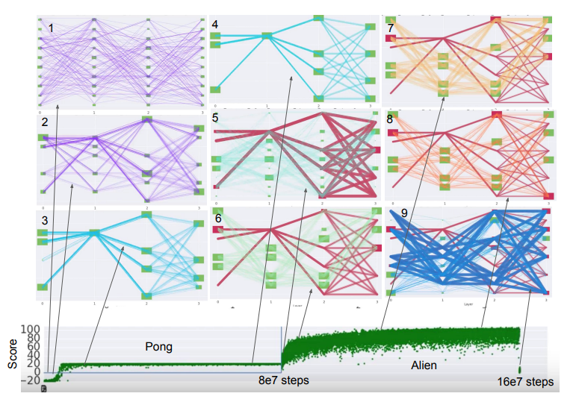
Chrisantha Fernando, Dylan Banarse, Charles Blundell, Yori Zwols, David Ha, Andrei A. Rusu, Alexander Pritzel, Daan Wierstra, “PathNet: Evolution Channels Gradient Descent in Super Neural Networks”, arXiv preprint, 2017
Chrisantha Fernando, Dylan Banarse, Charles Blundell, Yori Zwols, David Ha, Andrei A. Rusu, Alexander Pritzel, Daan Wierstra, “PathNet: Evolution Channels Gradient Descent in Super Neural Networks”, arXiv preprint, 2017

